Slide 1


Multi Modal Anomaly Detection - MSDAS Capstone Project
X
Bingcheng Wang, Chehak Arora, Marius Nwobi

Slide 2
Agenda
1. Anomaly Detection with Customer Care Chat
2. Anomaly Detection with Transactions
Approach 1:
Ensemble Methods using HDBSCAN, IsoForest, KMeans
Sentiment Analysis
Limitations & Recommendations with the first approach
Demo
Approach 2:
BERT
Future Implementations
Demo
Approach 1: Card/User information for Segmentation
Approach 2: MCC-Based Transaction Analysis
Final Approach
Demo
3. Key Takeaways & Recommendations

Slide 3
NLP Dataset
Problem Statement
Identifying anomalous conversations in large volumes of textual data is challenging due to class imbalance and the subtle nature of anomalies. Traditional anomaly detection models often fail to capture nuanced patterns, leading to low recall for rare anomalous cases.
Goal
Build a robust anomaly detection pipeline using a combination of feature extraction, dimensionality reduction, and clustering techniques.
Notes:
Imagine you're a support team at a bank getting hundreds of customer messages every day. Some are totally normal — like asking about card delivery — but others are serious, like fraud or stolen cards.
The problem is: These rare but important messages — the anomalies — are hard to catch. They're buried in normal conversations, and they don’t always use obvious words like “fraud” or “stolen.”
Traditional models struggle because:
There’s a huge imbalance — lots of normal cases, very few anomalies.
And anomalies are often subtle, written in ways that don’t stand out easily.
So, the goal of this project is to build a smart pipeline that:
Turns text into features a computer can understand,
Reduces the complexity of that data,
And clusters messages to detect what’s normal and what stands out as suspicious.
This helps spot potential fraud or support issues early, without needing a human to read every single message.

Slide 4
Model Choices for Sentiment Anomaly Detection
HDBSCAN | KMeans | Isolation Forest
Customer Queries Naturally Form Dense Topics | Catches inputs that are far away from average behavior in semantic space. | Sensitive to numeric and frequency anomalies (e.g., $500, overbilled, 3x charged).
Flags sentences that don’t belong to any dense group (e.g., “Why was I charged $100?”) | Useful when the complaint has the right structure but unusual intensity or emotion. | Operates on embedding-level variations, doesn’t care about cluster shape — good for subtle drift.
Great for identifying text that is rare in form or tone, like single complaints about fraud or lockouts. | Example: “My account was charged 4 times” sounds normal-ish but sits on the edge. | Balances the other two by being feature-agnostic.
Notes:
so here are the models that we used for this portion
HDBSCAN
The data is already in dense topic formats like card arrivals, exchange rate questions, extra charge, top up
Rare but Critical Anomalies Stand Out as Noise example my card was hacked
These occur less frequently but are semantically different enough to be flagged as outliers (i.e., noise points) by HDBSCAN.
Some topics are asked hundreds of times (card delivery), while others are rare (exchange rate errors, fiat support).
HDBSCAN’s density-based approach handles this variation far better than methods like KMeans (which assumes equal-sized clusters).
Kmeans
Again, KMeans forces every data point into a cluster, making it useful to model “typical” behavior.
If a new query lies far from all cluster centers, it's a strong sign of an anomaly.
e.g., "My wallet was stolen and charged 3 times in Malaysia" will lie far from the card_arrival or app_exchange centers.
Isolation Forest - Inputs like “I saw a $400 charge but didn’t buy anything” will stand apart from dense clusters of common queries like “Where is my card?”
Isolation Forest is good at finding global outliers that don’t belong to any cluster.
This complements:
HDBSCAN (which detects local anomalies in sparse clusters)
KMeans (which finds distance-based outliers)

Slide 5
Why Ensemble + Rule Logic Performs Best
Problem: No single model could reliably classify demo queries like: “I can’t access my account”, “I was overcharged”, or “Help, my card is blocked”
These are contextually anomalous but often structurally normal
Why Weighted Ensemble?
Each model "sees" anomaly differently
HDBSCAN: group density
KMeans: distance from mean
IsoForest: random partitioning of extremes
Ensemble ensures that if at least two models flag something, it’s taken seriously Weights are user-controlled, making the system adaptive to context
Why Add Heuristics?
ML models can't always understand intent (e.g., “I lost my card” = critical but linguistically mild)
We added rule checks for:
Unusually high dollar amounts
Suspicious phrases like unauthorized, locked out, pending charge
Notes:
Instead of relying on just one machine learning model, we combined several — like HDBSCAN, KMeans, and Isolation Forest — into an ensemble. Each model sees the data differently, No single model catches everything. By combining their scores and applying weights, we let each model vote — like a panel of expert.
Let’s say:
HDBSCAN says “Anomaly” → weight = 0.5
KMeans says “Normal” → weight = 0.25
Isolation Forest says “Anomaly” → weight = 0.25
🧮 Final weighted score: 0.5 (Anomaly) + 0 (Normal) + 0.25 (Anomaly) = 0.75
If your threshold is 0.4 → Final verdict = Anomaly

Slide 6
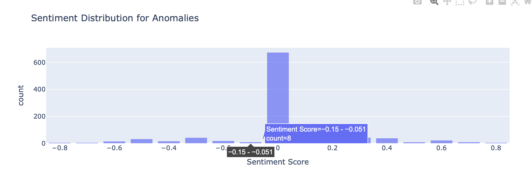
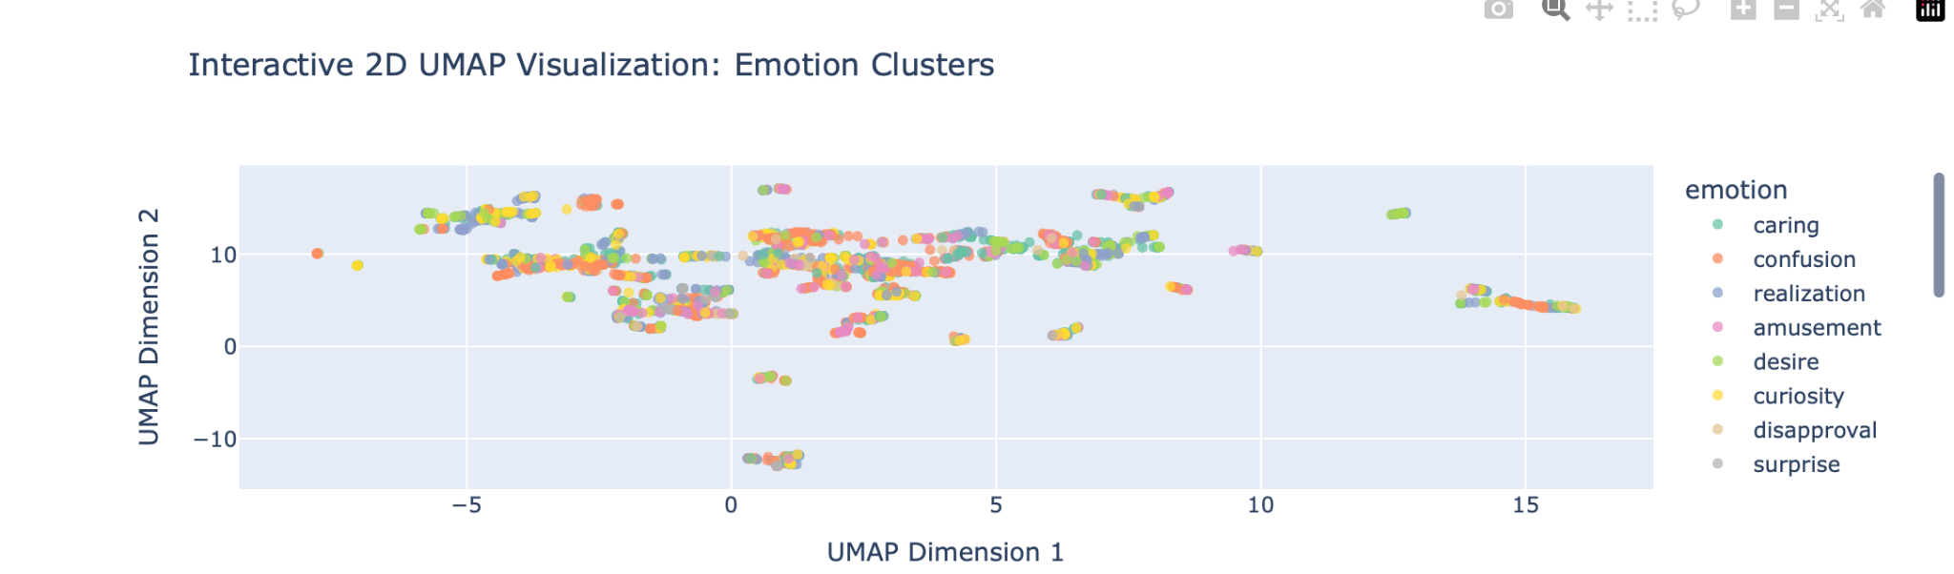
Sentiment Analysis of Conversations
Applied VADER (Valence Aware Dictionary and sentiment Reasoner) from NLTK to each conversation.
Extracted the compound sentiment score ranging from -1 (very negative) to +1 (very positive).
Classified conversations into:
Negative (compound < -0.05)
Neutral (-0.05 <= compound <= 0.05)
Positive (compound > 0.05)
Most conversations were neutral to slightly positive, as expected in standard customer service interactions.
A small number showed strong negative sentiment, which correlated with some anomalies.
Sentiment alone was not a strong predictor of anomalies but added context to anomaly classification.
Notes:
Customer complaints often carry emotional signals — frustration, urgency, or dissatisfaction.
While models like HDBSCAN or Isolation Forest look at structure/patterns, they don’t understand tone or mood.
Adds context to anomalies → A conversation flagged as an anomaly is more concerning if it also shows strong negative sentiment (e.g., fraud complaint, locked account).
Explains borderline cases → Some texts might look normal structurally but show emotional distress — sentiment reveals that hidden signal.
Helps prioritize → Among all detected anomalies, negative ones can be prioritized for faster investigation or support follow-up.

Slide 7
Limitations & Recommendations
Current Limitations
No true anomaly labels — Hard to benchmark model accuracy, relying on synthetic samples.
Imbalanced dataset — Dominated by benign classes like card_arrival, leading to biased clustering.
Shallow structure-based models — Struggle with semantic intent (e.g., “my card was stolen” may seem normal).
Rule-based heuristics — Effective but brittle; need manual updates for evolving language.
Surface-level sentiment analysis — Lexicon-based, misses sarcasm or context.
Data Constraints
Short, vague queries with limited context.
No metadata (timestamps, user history) for deeper behavioral modeling.
Synthetic anomalies may not reflect real-world fraud.
Recommendations
Add real anomaly labels from support/fraud logs for model validation.
Upgrade from MiniLM to stronger sentence models like all-mpnet-base-v2 (SentenceTransformers) or even integrate OpenAI’s text-embedding-3-small if possible.
Use transformer-based or LLM models for deeper intent detection.
Implement dynamic rule management for easier heuristic updates. Explore autoencoders for unsupervised anomaly scoring.

Slide 8
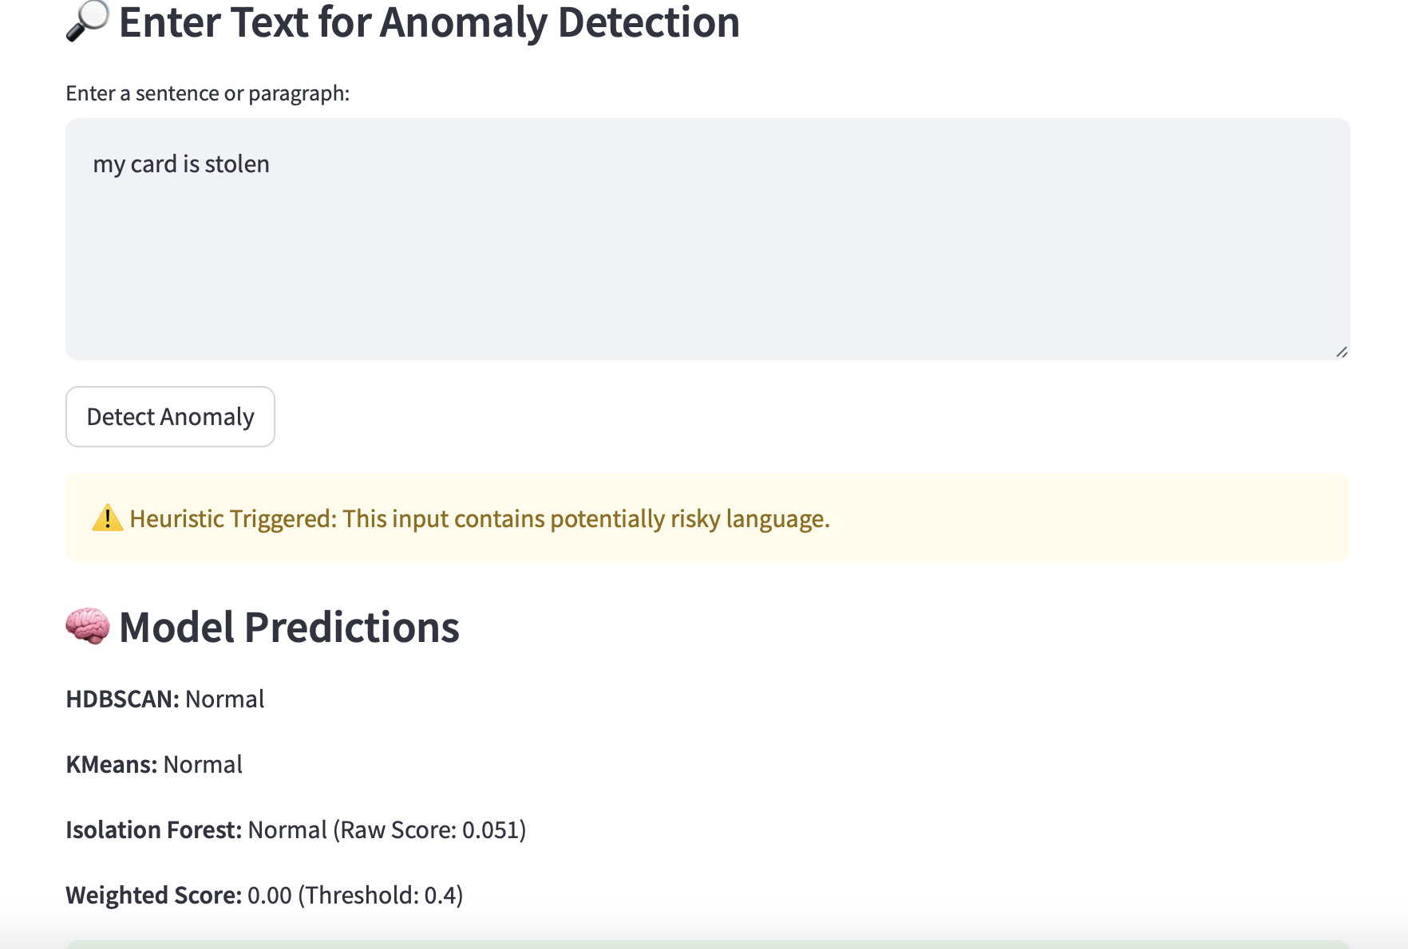

Slide 9
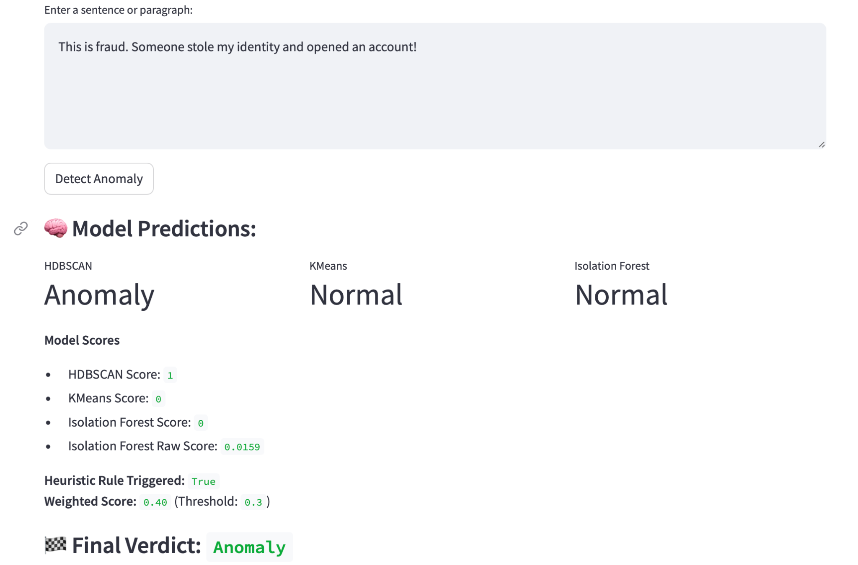

Slide 10
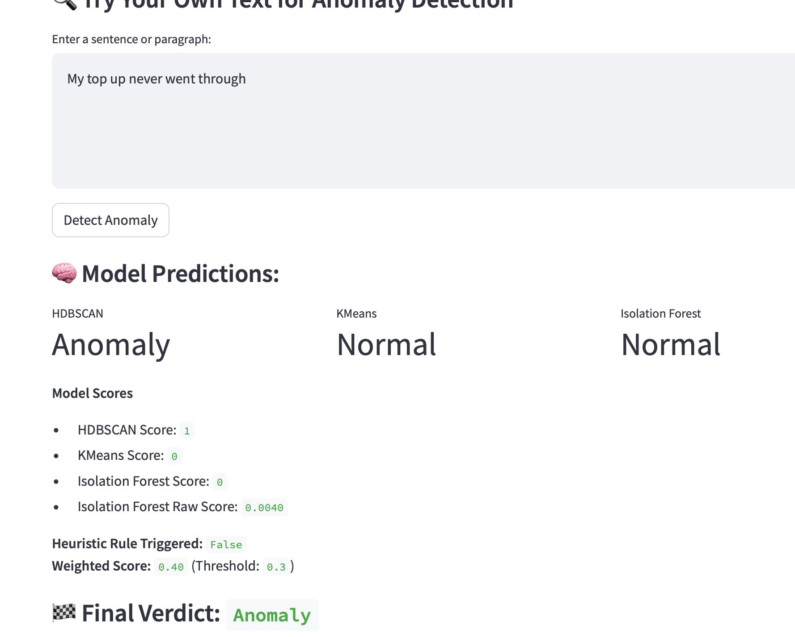

Slide 11
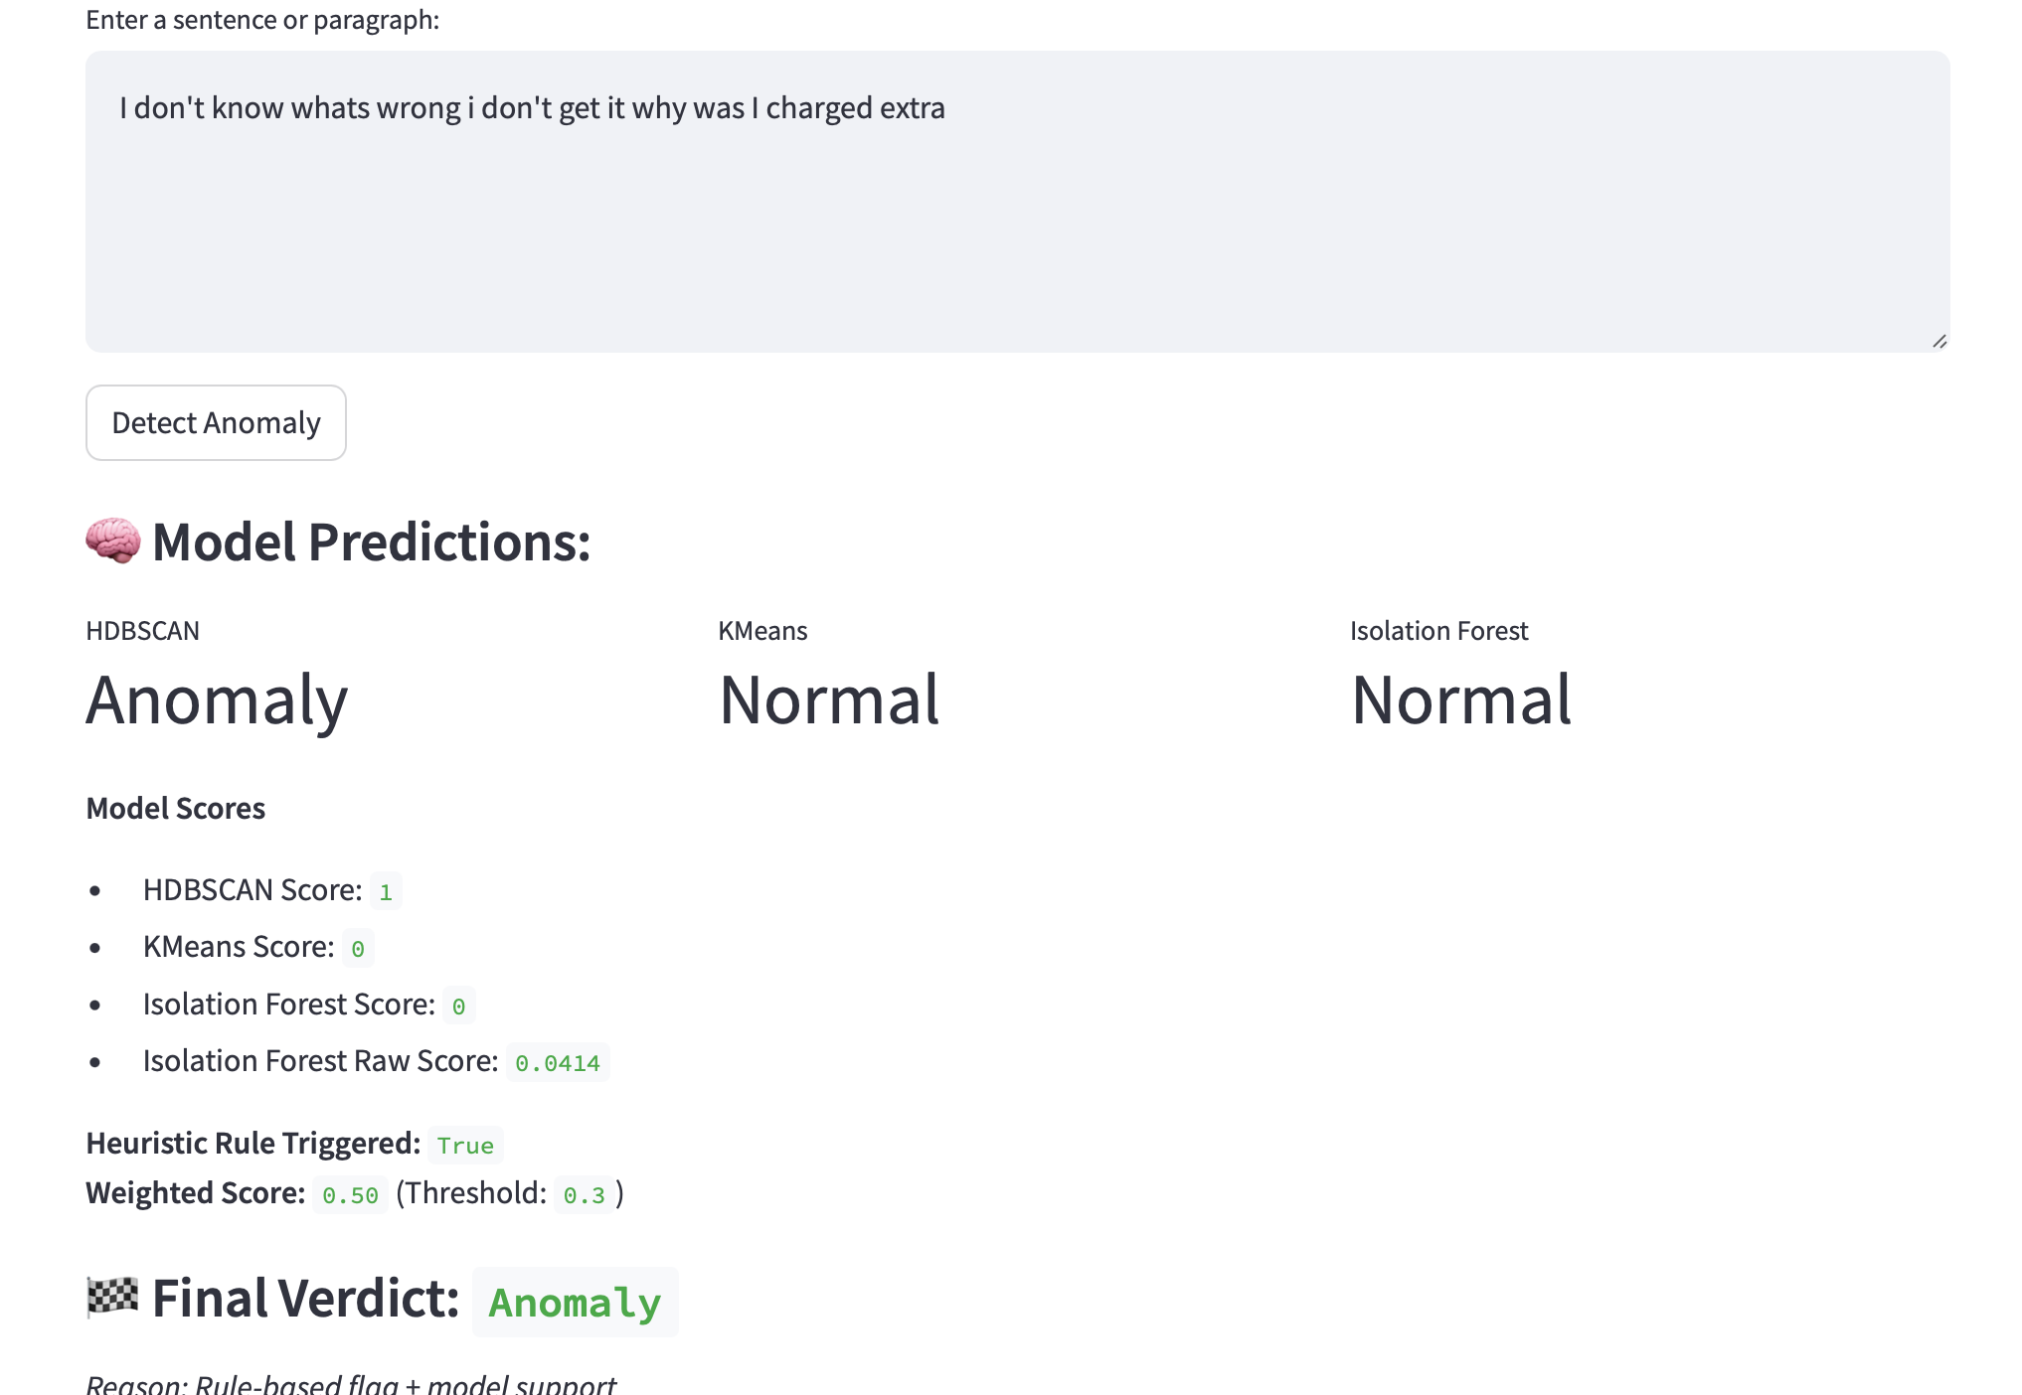

Slide 12
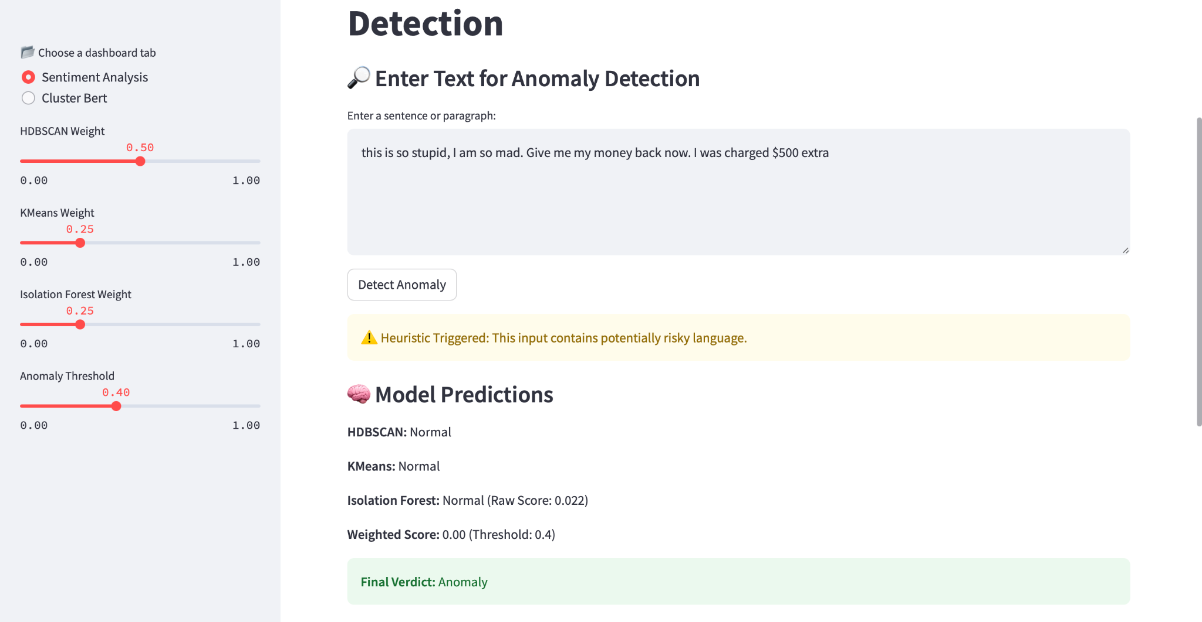

Slide 13
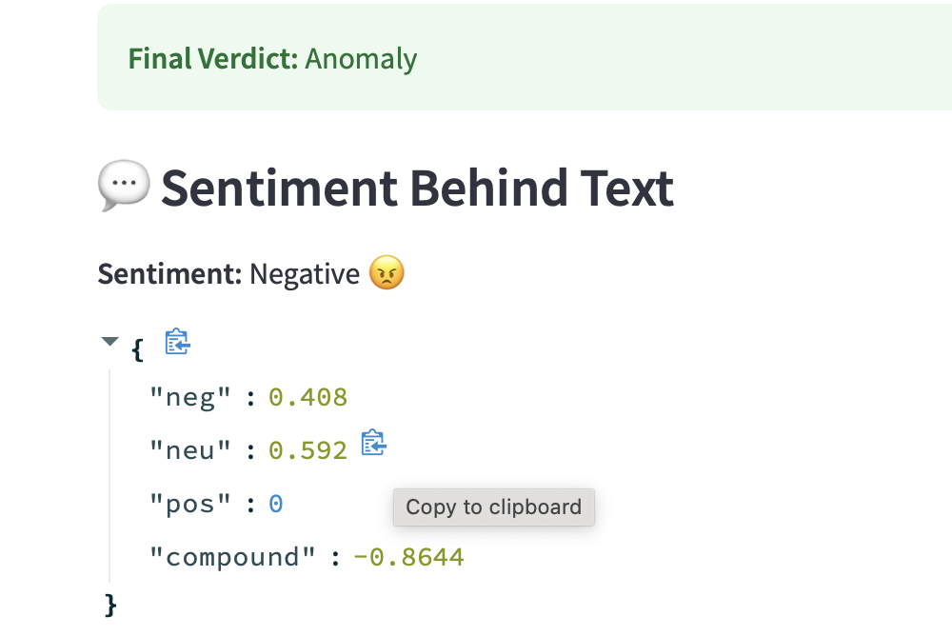

Slide 14
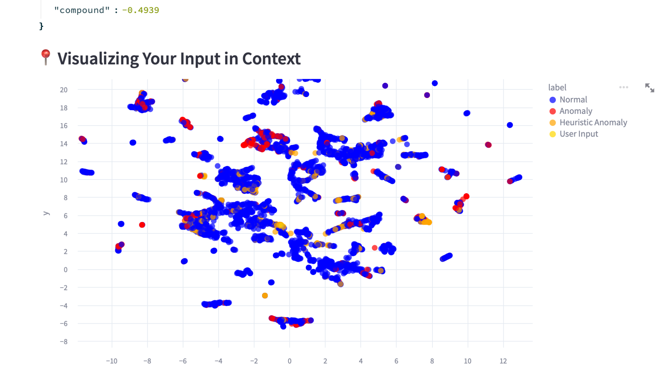

Slide 15
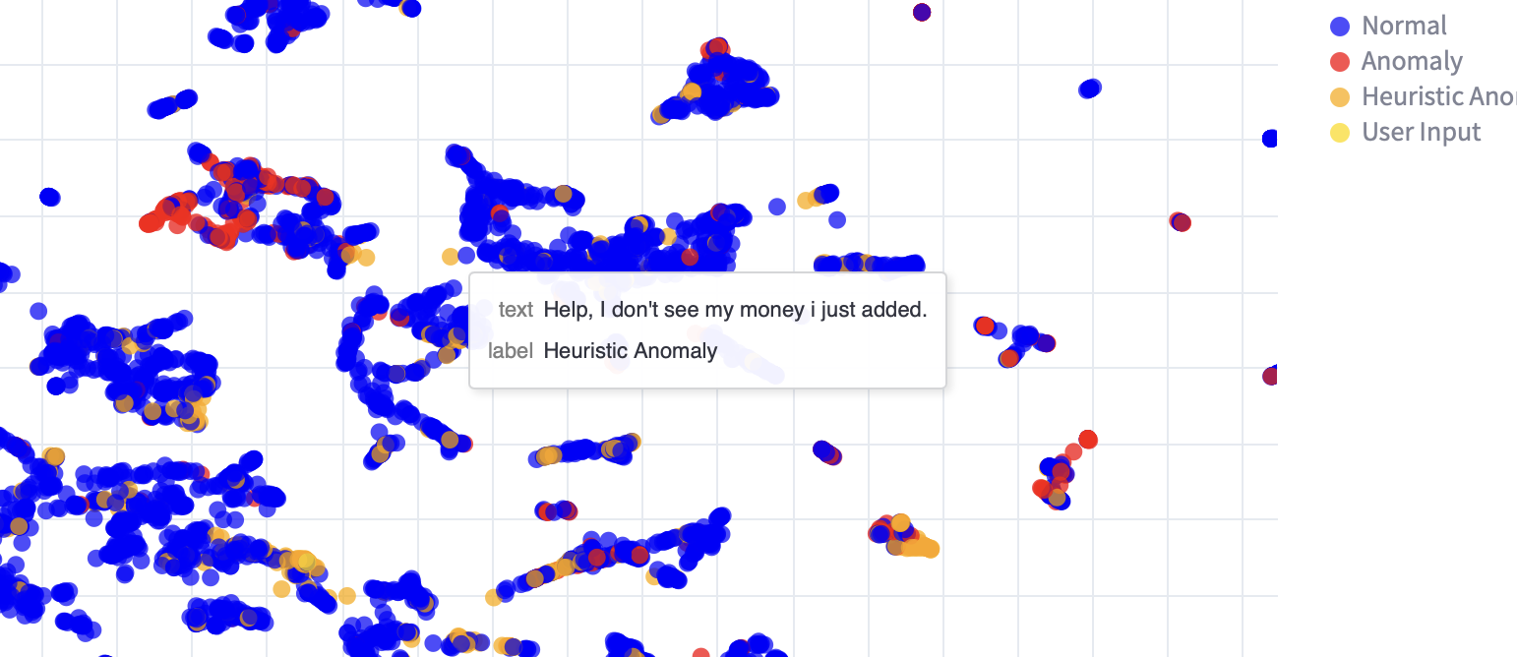

Slide 16
Anomaly Detection With BERT and Unsupervised Learning
What even is BERT ?

Slide 17


Slide 18
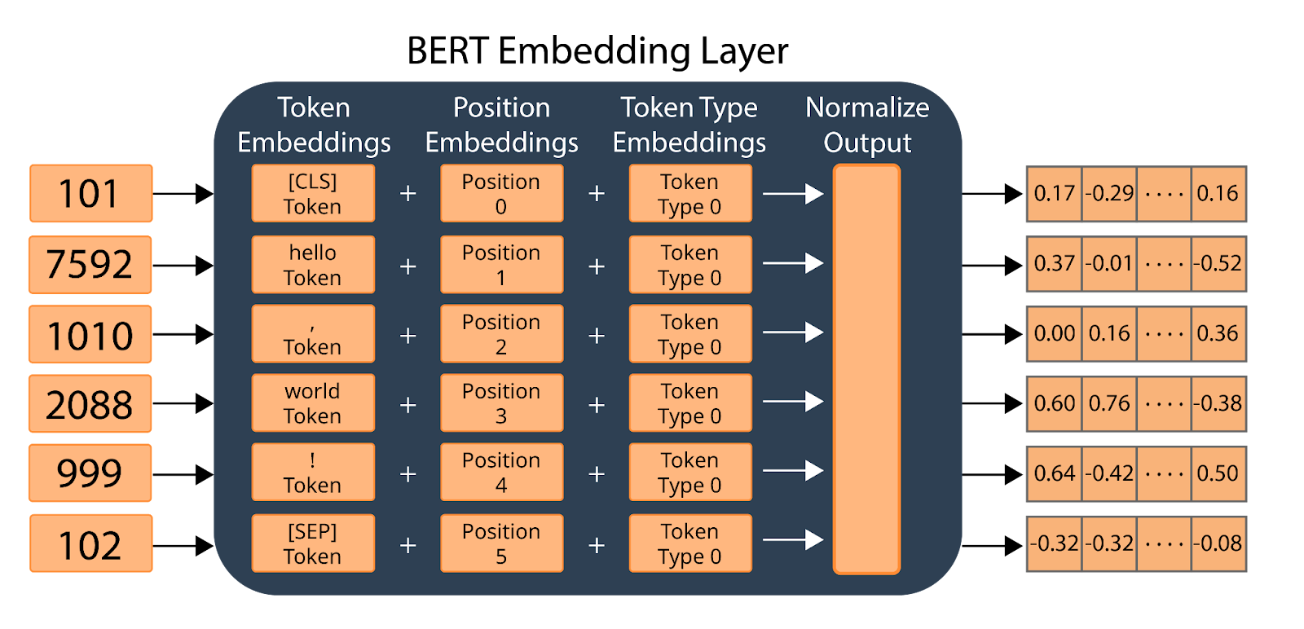
BERT
encoder only model
Understands semantic representation of text
Ideally similar sentences should be vectorized in similar places

Slide 19
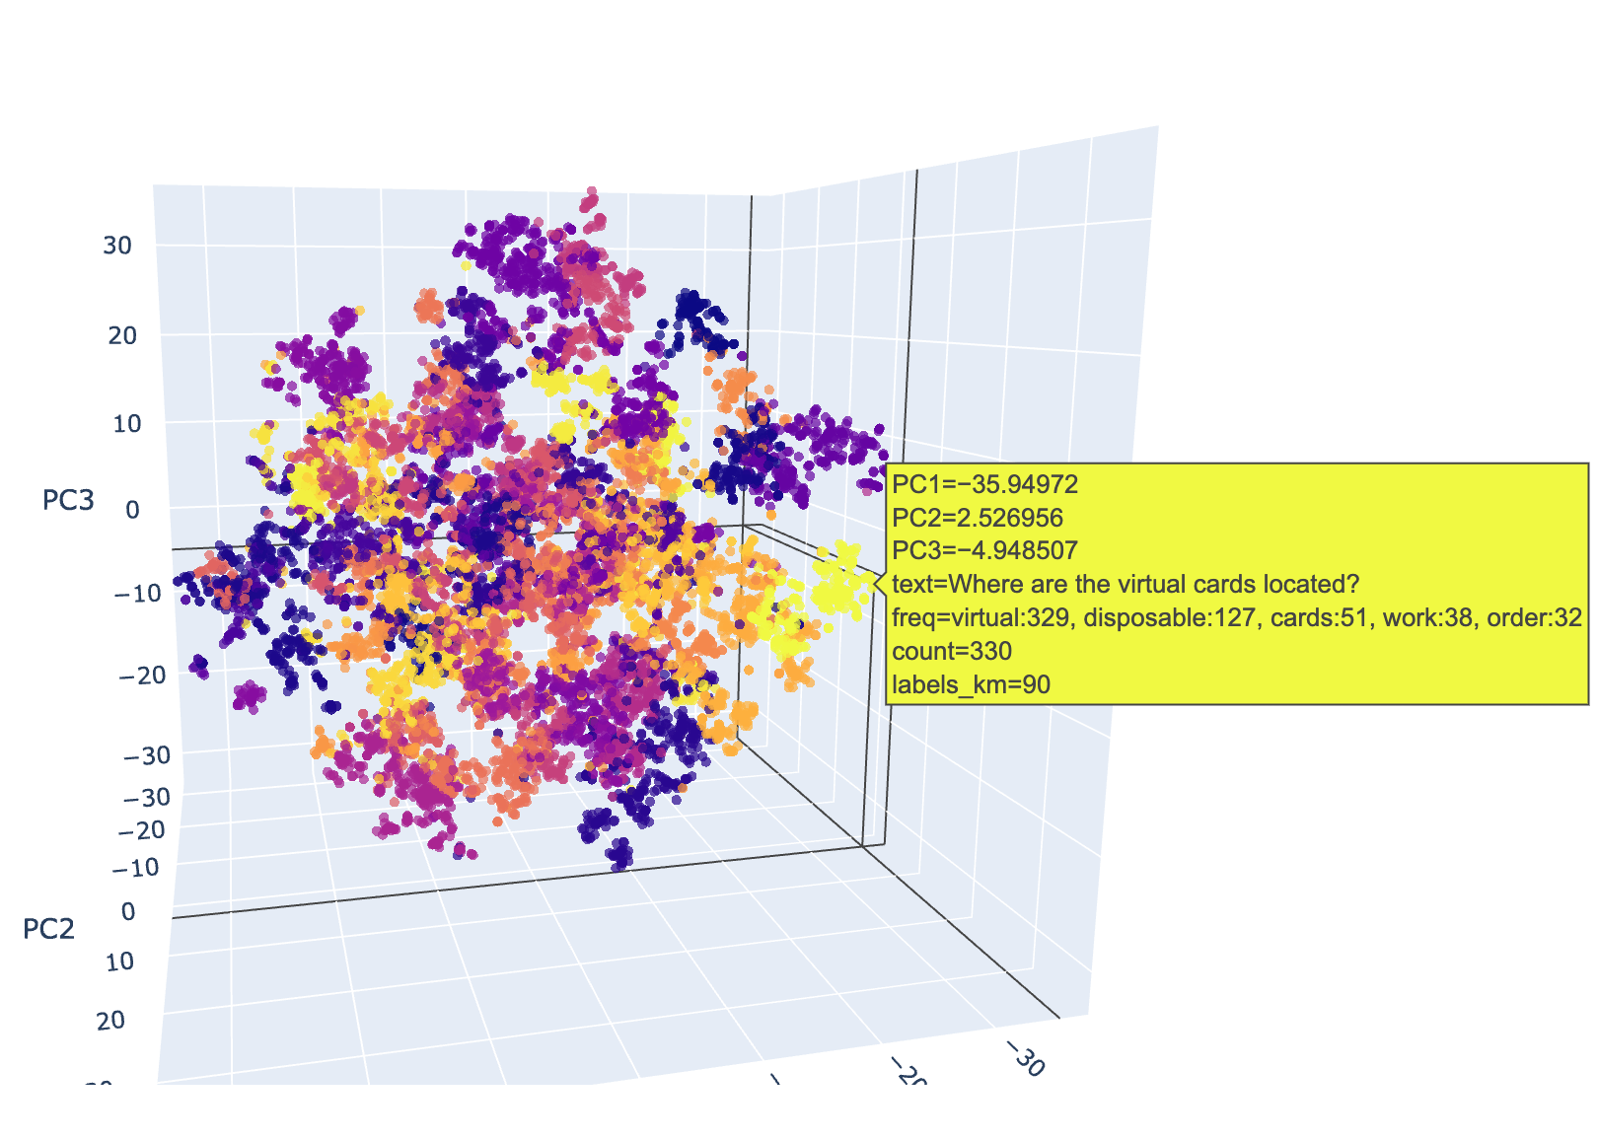
Clusters !
Example of TSNE with Kmeans (93 clusters)
Can reduce vectors to visualize separation
Can create clusters via unsupervised learning
Naming Convention
noun:verb, noun:verb, noun:verb

Slide 20
DEMO
Use BERT to get embeddings
Use TSNE for dimension reduction
Kmeans for cluster creation
Manually sorted clusters into anomaly levels based on clusters
High: Urgent issues (e.g., missing funds, theft, refund)
Mid: Needs attention but not urgent (e.g., pending transactions, profile updates)
Low: Informational or non-critical (e.g., card types, service inquiries)

Slide 21


Slide 22
Future implementations
FInd better topic names / method
Test with HDBSCAN
Instead of unsupervised learning, do supervised learning

Slide 23
Transaction Anomaly Detection
Goal
To develop a front-end service tailored for PNC Bank data scientists that allows users to upload transaction data, automatically apply one or more regulatory-allowed fraud detection models, and interact with the results. The tool should support functionalities such as downloading prediction outputs, interpreting model insights (e.g., using SHAP values), and enabling rapid investigation of potentially fraudulent activity.

Slide 24
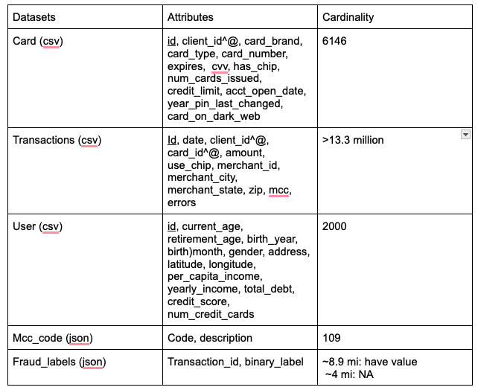
Data

Slide 25
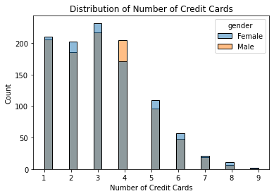
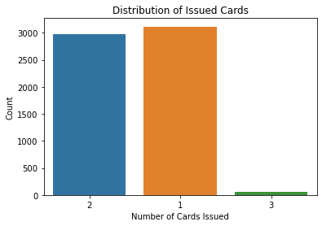
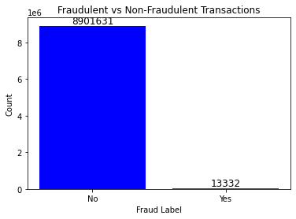
Challenges - Other concerns
Complex Card Ownership: Some cards are joint credit cards or have authorized users added, and users may have multiple cards, which can make the incorporation of user information problematic for fraud analysis.
Highly Imbalanced Data: There is a significant imbalance between fraud and non-fraud transactions, complicating the detection process.

Slide 26
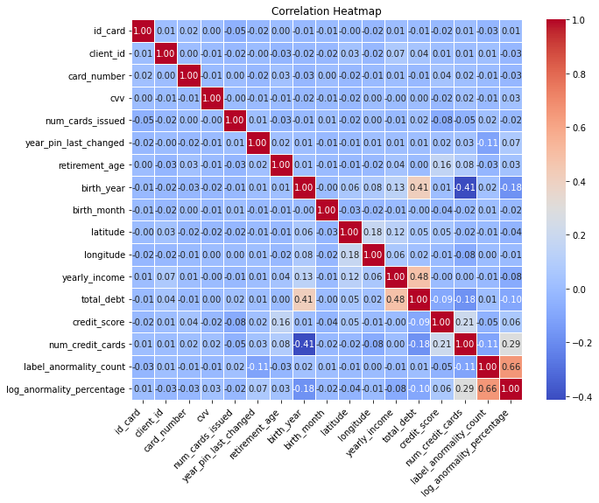
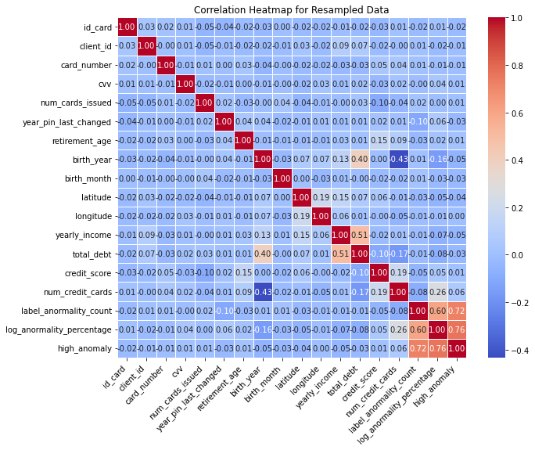
Attempt 1 - Card/User information for Segmentation
Unclear relationship between card/user information and fraudulence

Slide 27
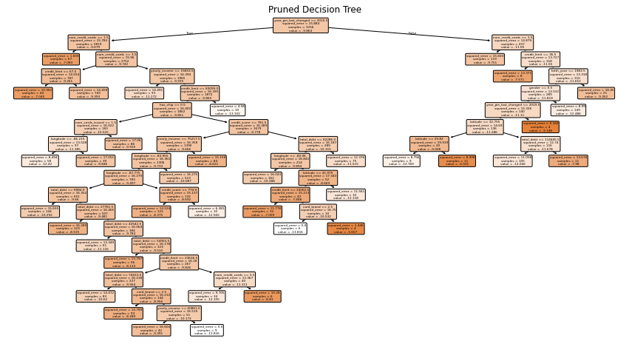
Attempt 1 - Card/User information for Segmentation

Slide 28
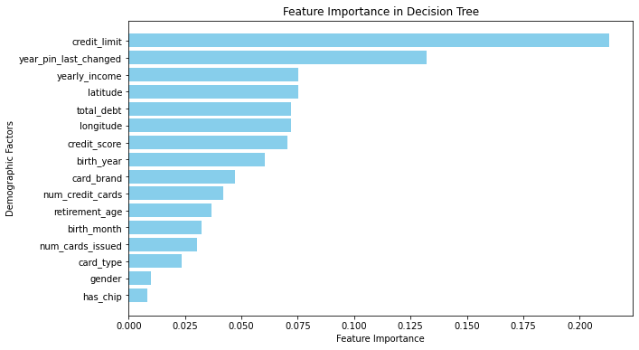
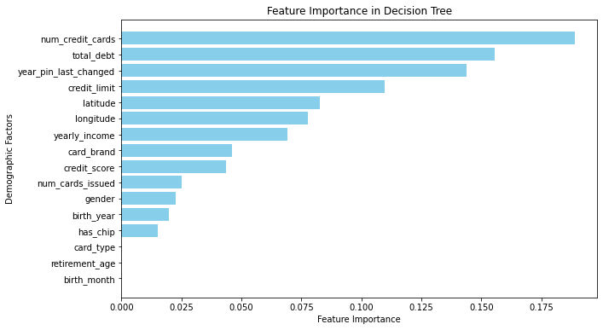
Attempt 1 - Card/User information for Segmentation
Original Data
Oversampled Data

Slide 29
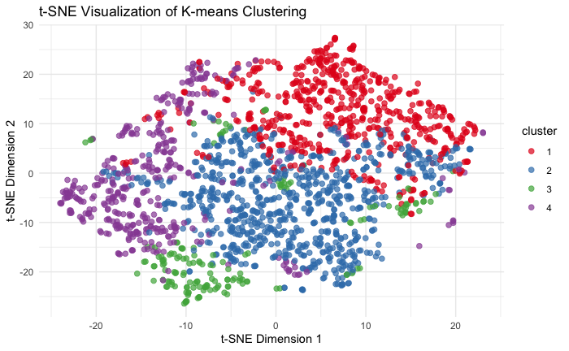

Attempt 1 - Card/User information for Segmentation
Unclear relationship between card/user information and fraudulence

Slide 30
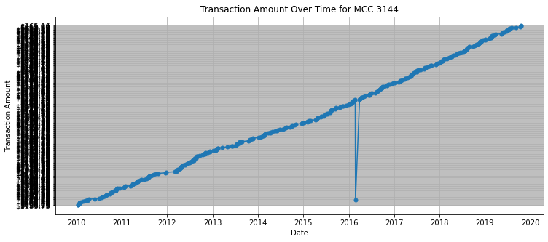
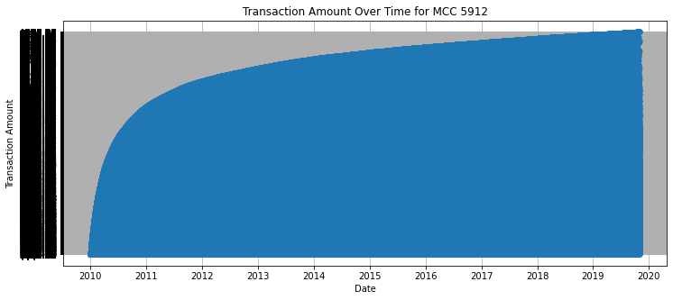
Attempt 2: MCC-Based Transaction Analysis

Slide 31
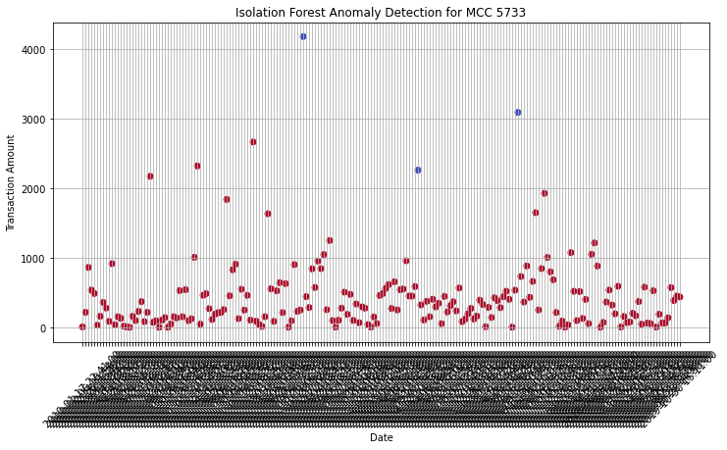
Attempt 2: MCC-Based Transaction Analysis
Isolation Forest on 5733 MCC
3 predicted abnormality
76 abnormality in 204 transactions
Moving average on 5912 MCC
window_size - 3
Threshold of standard deviation: 1
479 in totally 517,400 transactions
Precision: 0.0014
Recall: 0.5031
Weighted F1 Score: 0.7959
Key Insight: fraud ≠ anomaly

Slide 32
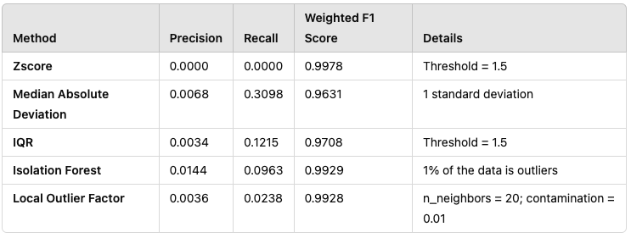
Attempt 2: MCC-Based Transaction Analysis
Feature Engineer:
Moving Average base on MCC category
Exponential Moving Average
Centralization
Standardization

Slide 33
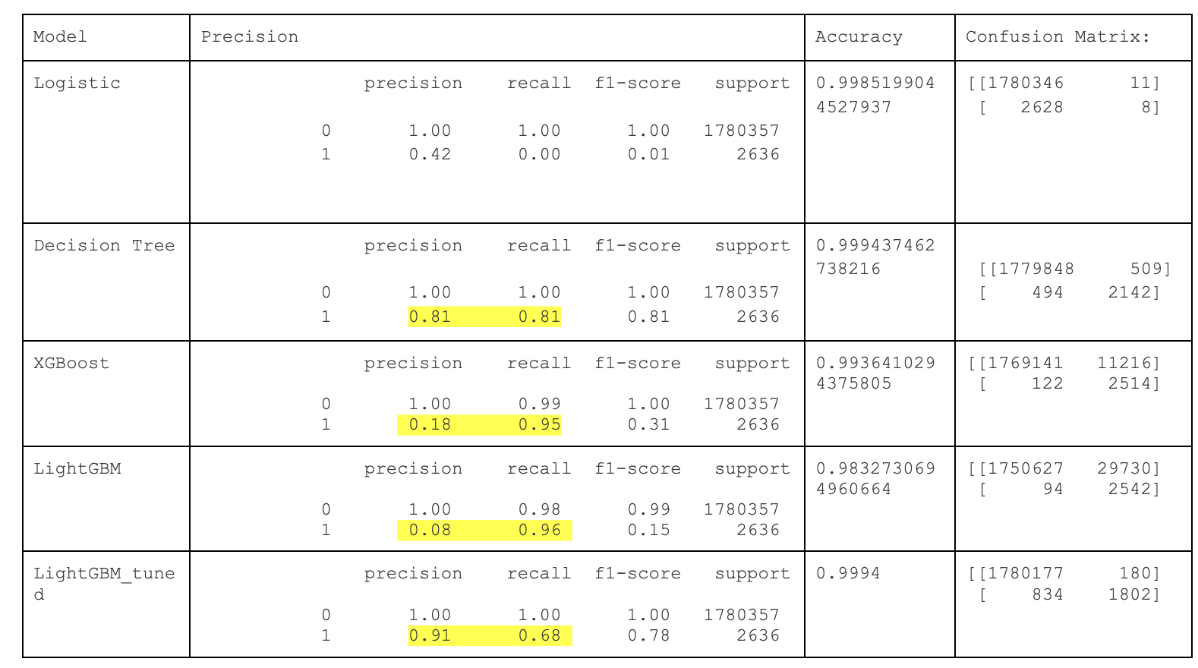
End-to-End Classification Without Grouping: A Scalable Approach

Slide 34
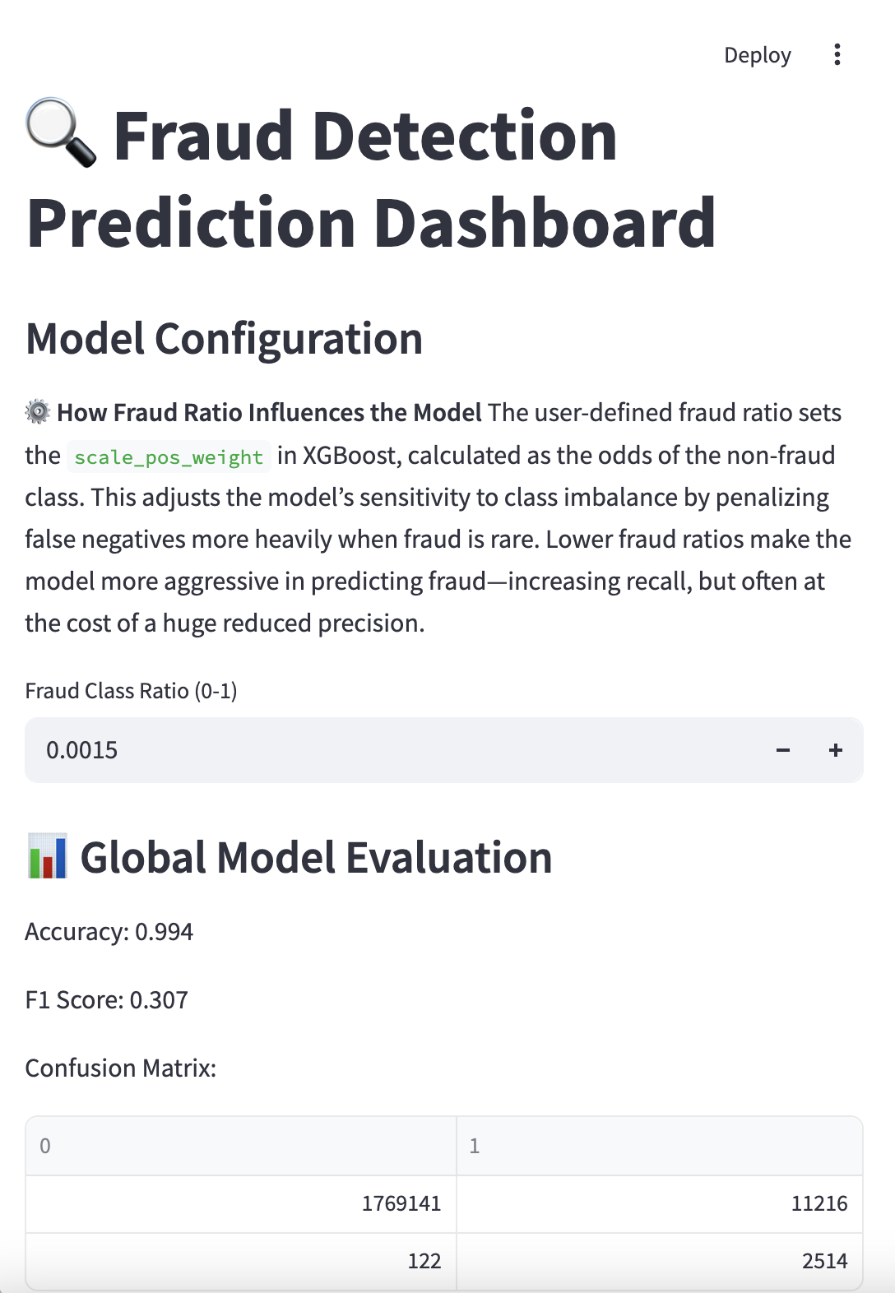
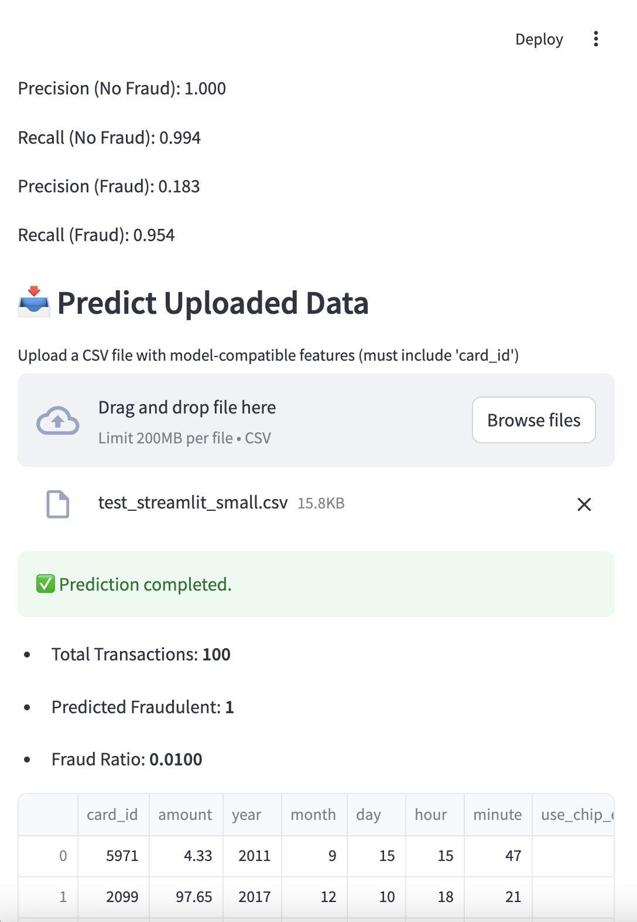
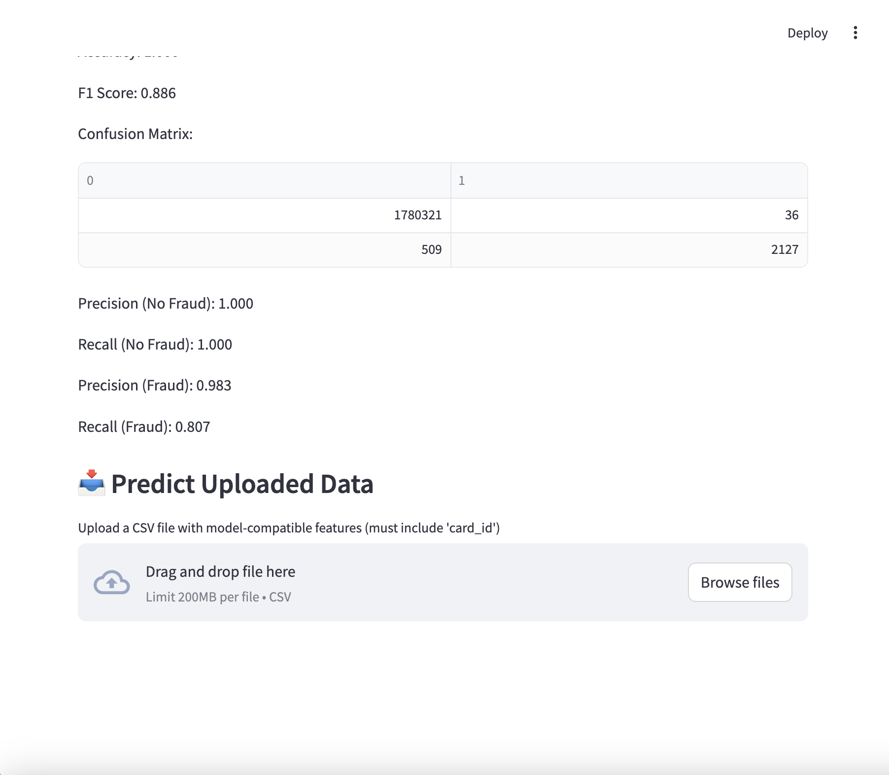
http://localhost:8501/
Notes:
http://localhost:8501/

Slide 35
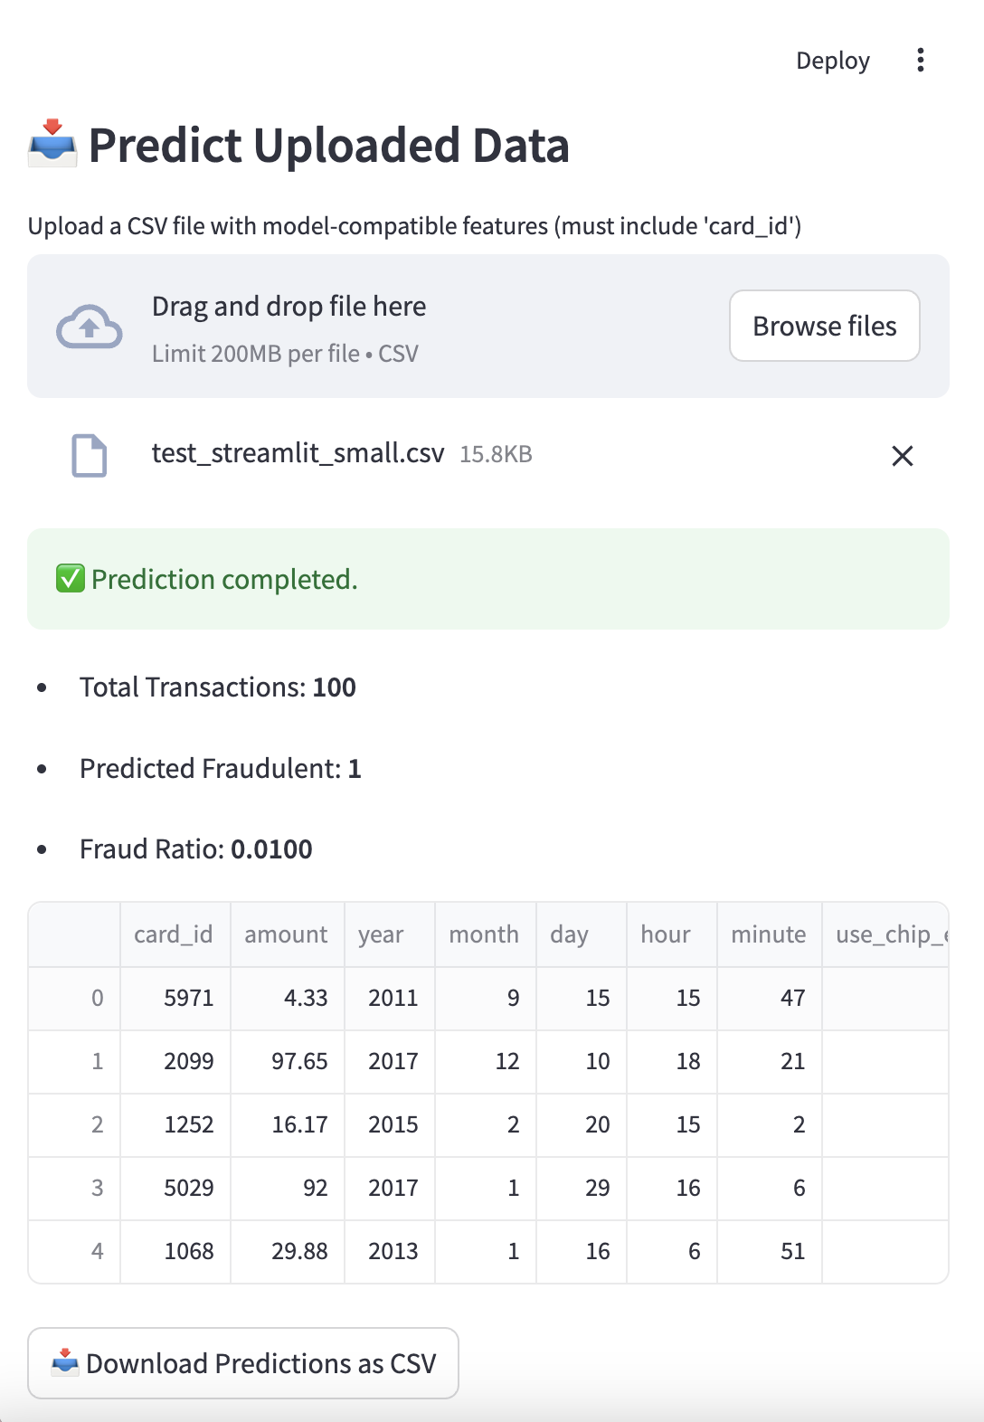
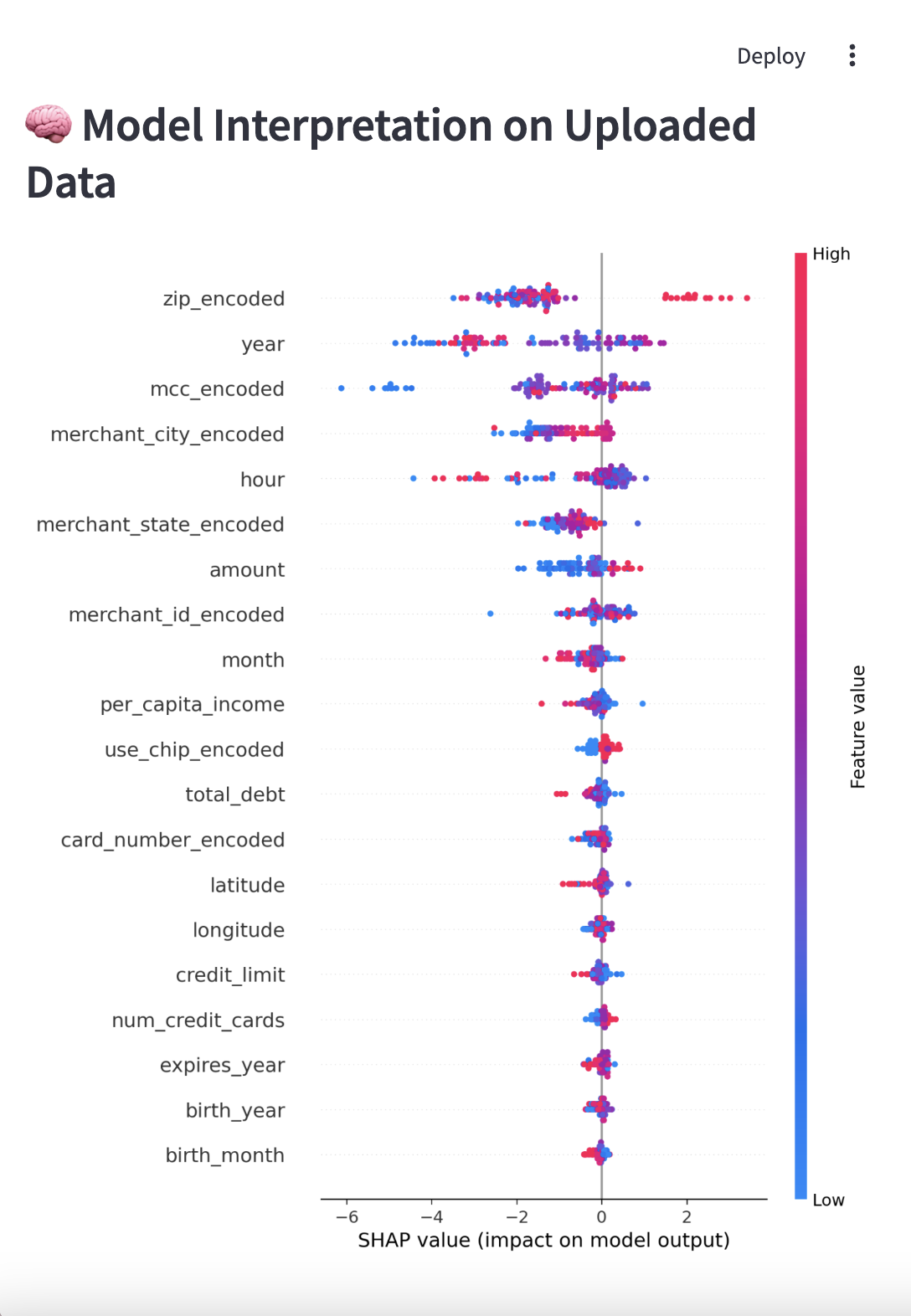

Slide 36
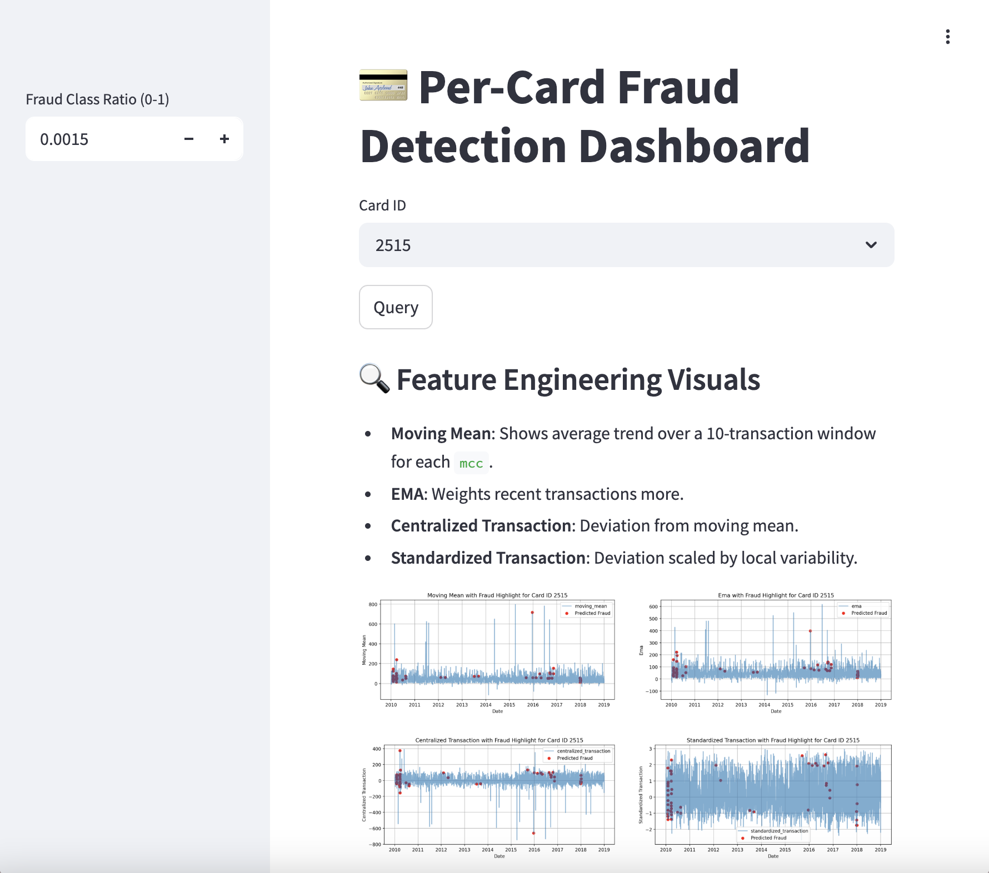
http://localhost:8501/
Notes:
http://localhost:8501/

Slide 37
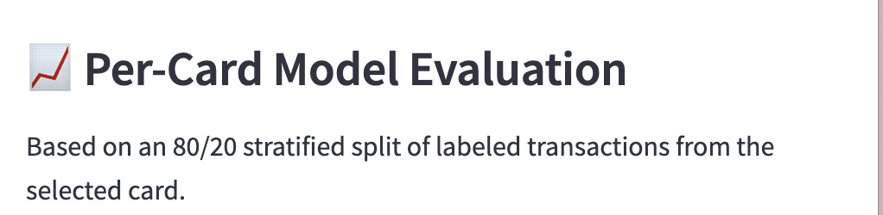
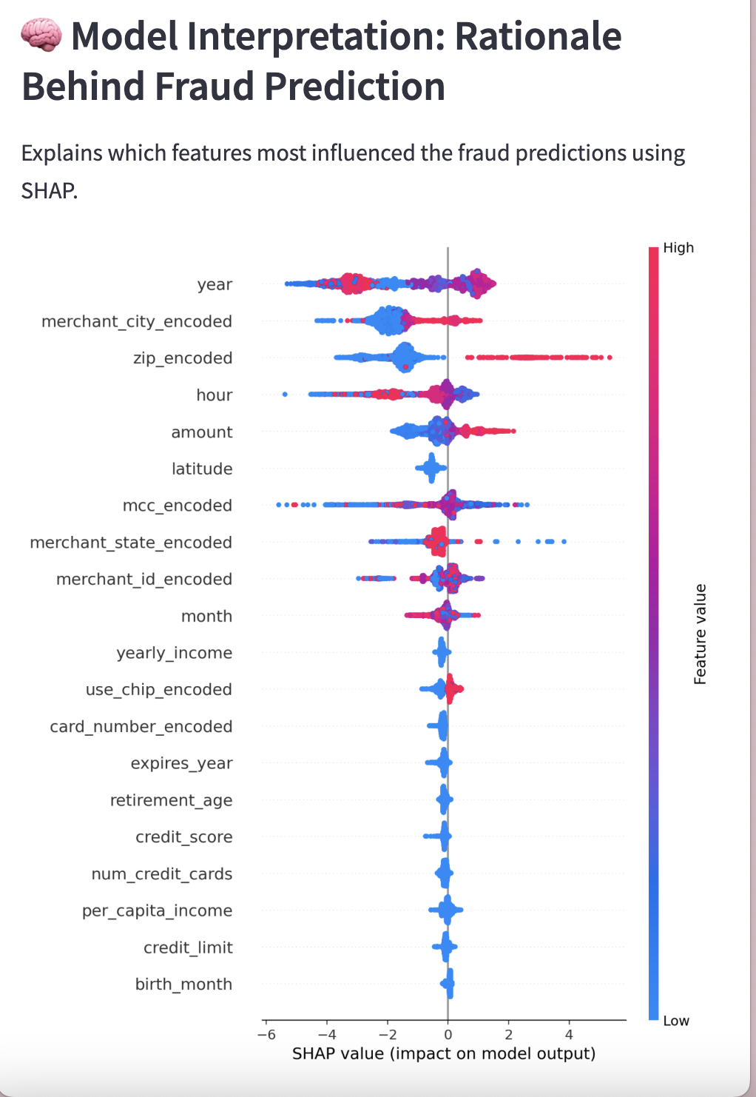
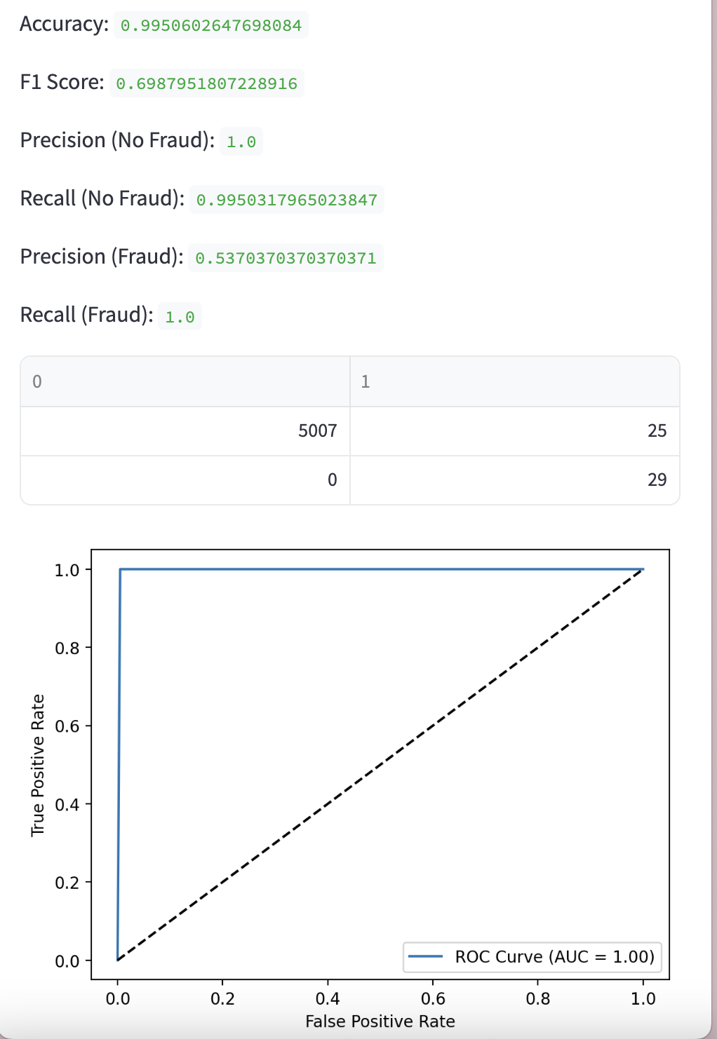

Slide 38
Key Takeaways and Future Directions
Hybrid Anomaly Detection is Effective
Combining unsupervised clustering, isolation methods, and rule-based heuristics improves recall without heavily sacrificing precision.
Model Explainability Matters
SHAP values and real-time sentiment analysis made results more transparent, increasing user trust.
Streamlit Enables Fast Iteration
Easily test hypotheses, explore data, interpret predictions, and stay compliant.
Next Steps
Adding sequential models like LSTMs, Autoencoders, Contrastive Learning to capture behavioral patterns.
Incorporating LLMs to understand nuanced language, capturing context and detecting intent
Improving segmentation with richer, less anonymized data.
Expand heuristics using NLP-based intent detection.

Slide 39
Thank you!

Slide 40
Streamlit Dashboard
Seamless Integration of Machine Learning: Multiple unsupervised models (HDBSCAN, KMeans, Isolation Forest) and heuristics combined into a live anomaly detection system.
Real-Time Scoring and Visualization: User inputs are encoded, scored across models, and verdicts are dynamically weighted and visualized immediately.
Efficient Data Handling: Sentence embeddings, clustering, model predictions are cached to optimize response time and minimize memory usage.
Explainable ML Outputs: SHAP explanations for Time Series fraud predictions and Sentiment breakdown for customer text complaints, enhancing trust and model transparency.
Extensible Framework: New models (e.g., fine-tuned classifiers, additional heuristics) can be added into the ensemble with minimal changes.

